Slide 1

SMART SOLUTIONS SEMESTER
L.26195 Testing device membrane fabrics for motorcycling
November 2019
Notes:
Femke

Slide 2

CONTENT
Introduction
The prototype
Demonstration
Next steps
Questions
Notes:
Femke

Slide 3
INTRODUCTION
REV’IT!
Ensuring comfort and safety
Create a testing device which can determine the breathability of a fabric by measuring the weight of the cup, the temperature and the humidity.
Notes:
Isabel

Slide 4
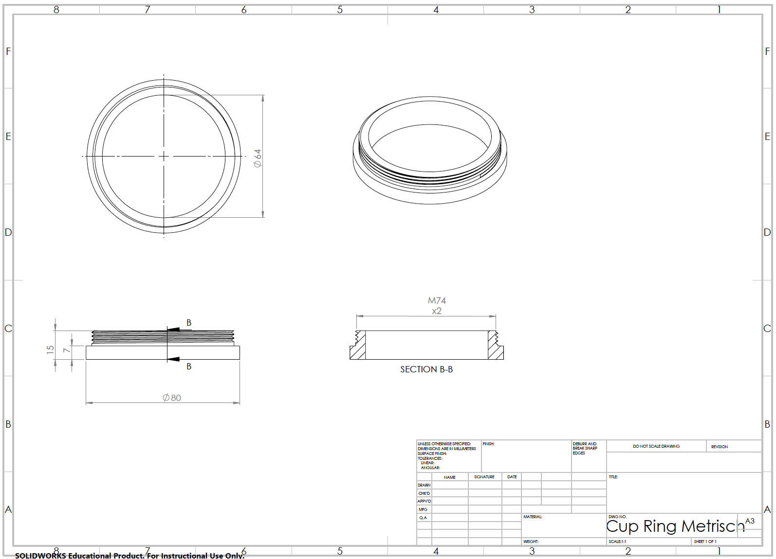
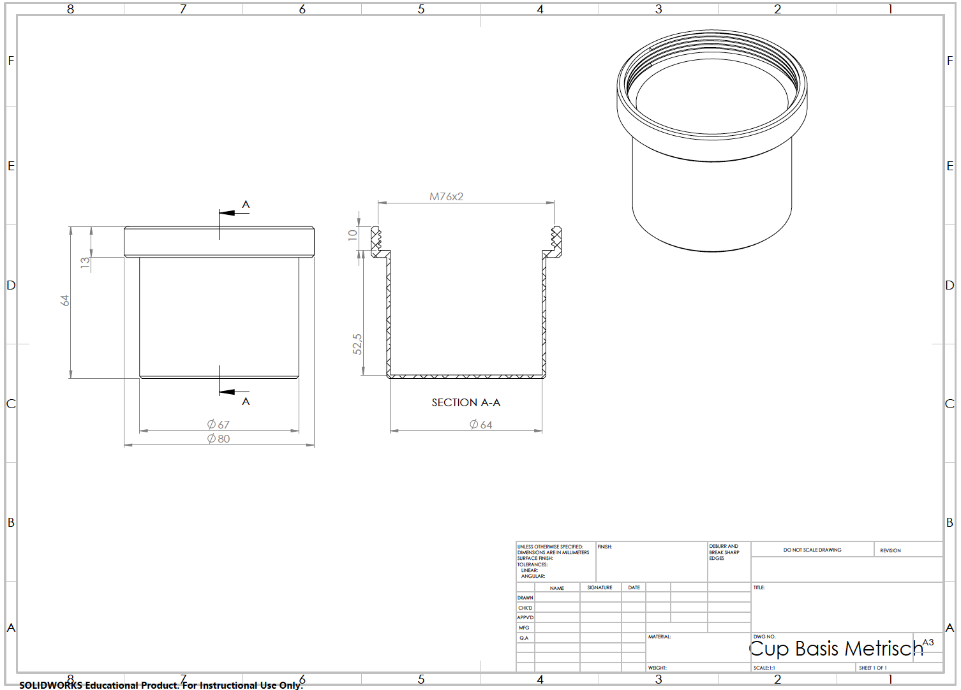
THE PROTOTYPE
Notes:
Dimitar

Slide 5
THE PROTOTYPE
Notes:
Minh

Slide 6
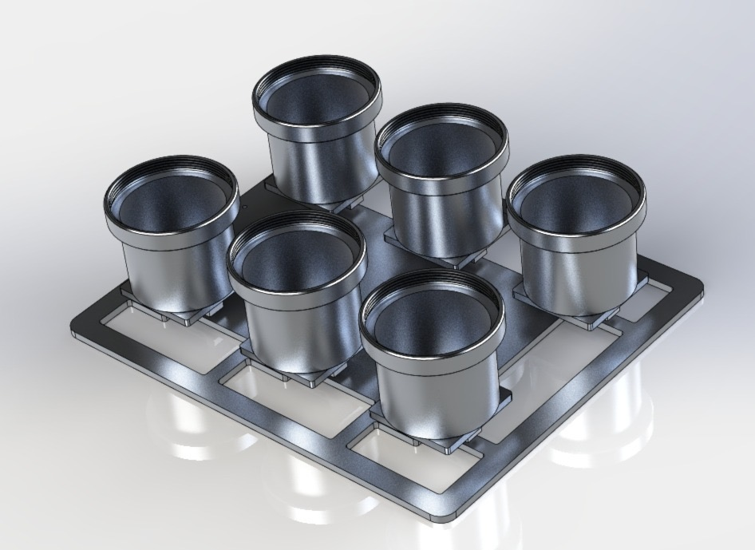
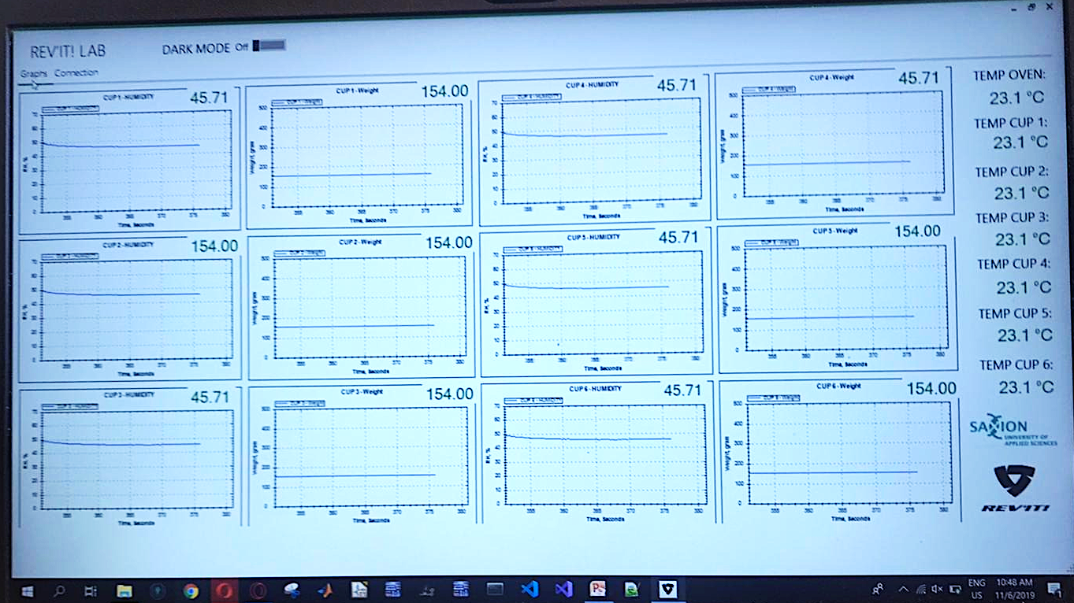
THE PROTOTYPE
Notes:
Harold

Slide 7
DEMONSTRATION
Notes:
Dimitar

Slide 8
NEXT STEPS
Creating a tray of aluminium
Testing the device
Testing fabrics inside the oven
Evaluate the results
Notes:
Minh

Slide 9
QUESTIONS?
Notes:
Isabel

